Slide 1

STUDENT NAME: THAMARAI SELVI E NAAN MUDHANVAN ID: 312208799 DEPARTMENT: B.COM [GENERAL] COLLEGE: MEENAKSHI COLLEGE FOR WOMEN

Slide 2
PROJECT TITLE
Employee Analysis Based on Department and Gender using Excel

Slide 3
index
Problem Statement
Project Overview
End Users
Our Solution and Proposition
Dataset Description
Modelling Approach
Results and Discussion
Conclusion

Slide 4

PROBLEM STATEMENT
To analyze the employees across different departments based on gender and areas of improvement in organizational practices.
This analysis aims to support the organization's goals of enhancing employee performance while fostering an inclusive and equitable workplace.

Slide 5

Project overview
This project involves analyzing an employee dataset using Excel to create visual representations of key workforce metrics.
The focus is on diversity, employment types (permanent vs. temporary), location and employee termination trends.
The goal is to provide clear and actionable insights that can help the HR department and management in decision-making processes.

Slide 6

Who are the end users?
The primary end users of this project are :
HR professionals
Management teams
Employees
Supervisors
Analysts
Creditors

Slide 7

Our solution and its value proposition
The solution involves using Excel to create various charts and graphs that visualize the employee data effectively.
By breaking down the data into understandable components, such as diversity metrics, employment types, pay zones, and termination rates, the project provides a comprehensive overview of the workforce.
The value proposition lies in the ability to quickly identify trends, disparities, and areas of improvement, ultimately aiding in more informed decision-making

Slide 8
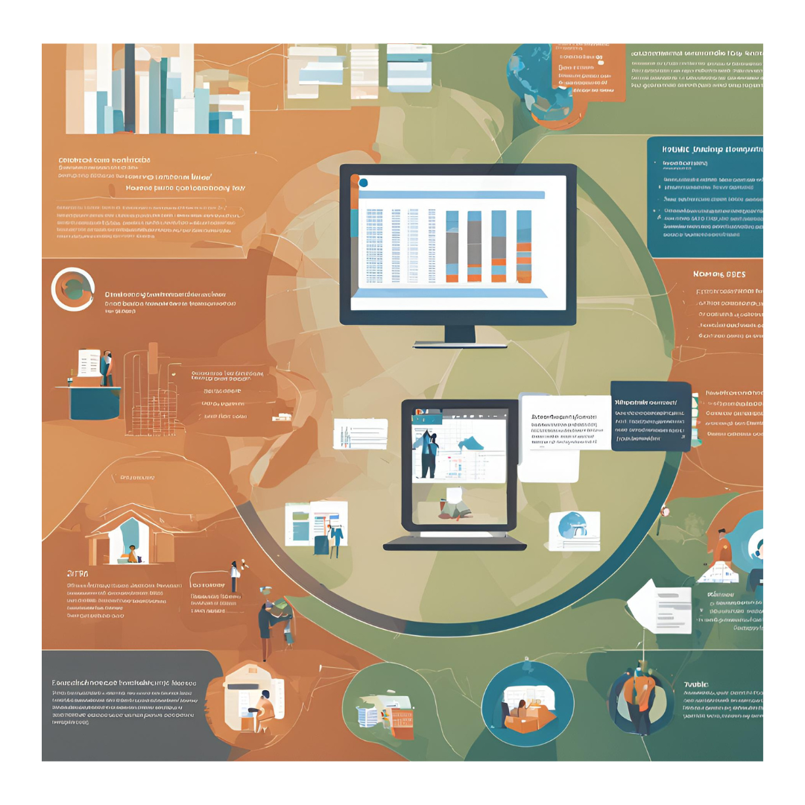
Dataset description
The dataset includes employee demographics, employment type (contract, full-time, part-time), pay zone information, and termination records.
This data provides a holistic view of the workforce, allowing for the analysis of various aspects of employment within the organization.

Slide 9
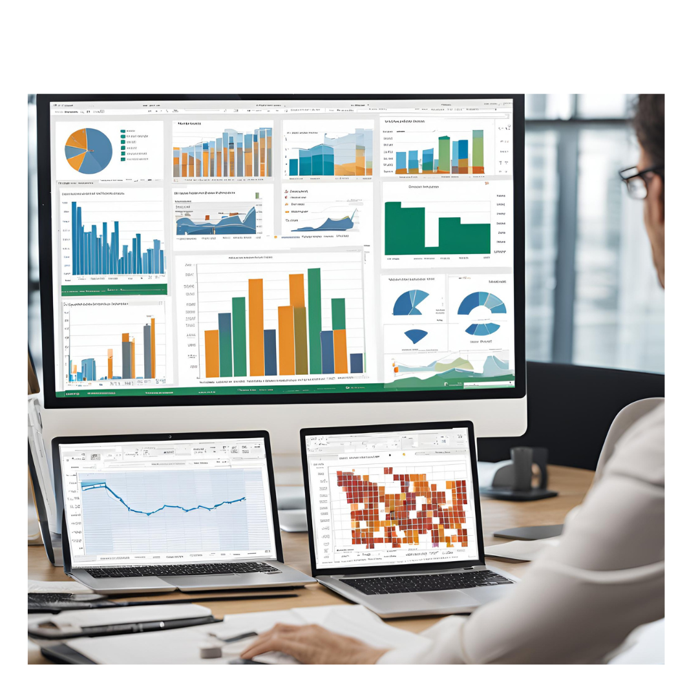
The “wow” in our solution
The "wow" factor in this solution is the simplicity and accessibility of using Excel to uncover deep insights from complex employee data.
Despite the challenges of handling diverse data points, the visualizations offer a clear, engaging, and easily interpretable view of the workforce.
This empowers users to make data-driven decisions without needing advanced analytical tools.

Slide 10
modelling
The modeling process involved organizing the employee data into relevant categories and preparing it for visualization.
This included the creation of pivot tables to segment the data based on various attributes such as employment type, pay zone, and diversity metrics.
Excel functions were used to calculate necessary metrics, and filters were applied to isolate specific segments of the data for in-depth analysis.
Once the data was structured, charts such as bar graphs, pie charts, and line graphs were created to visualize the relationships and trends within the dataset.

Slide 11
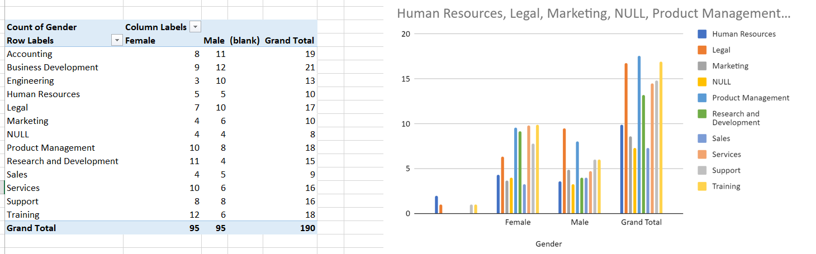
results

Slide 12
CONCLUSION
The data visualization project successfully transformed raw employee data into meaningful insights through the use of Excel.
By focusing on key workforce metrics such as diversity, employment types, pay zones, and termination trends, the project provides HR professionals and management with a comprehensive view of the organization’s workforce.
The intuitive and accessible visualizations created offer a powerful tool for understanding complex data, allowing for more informed decision-making and strategic planning.
The simplicity and effectiveness of the Excel-based approach demonstrate that even without advanced tools, significant insights can be derived, making this project both impactful and practical for any organization looking to optimize its human resources management.

Slide 13


